Slide 1
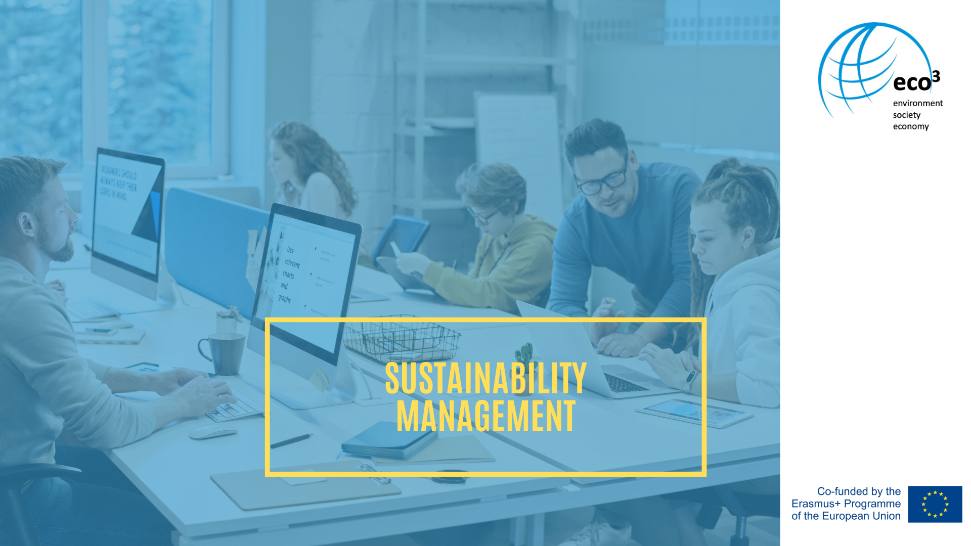

Slide 2
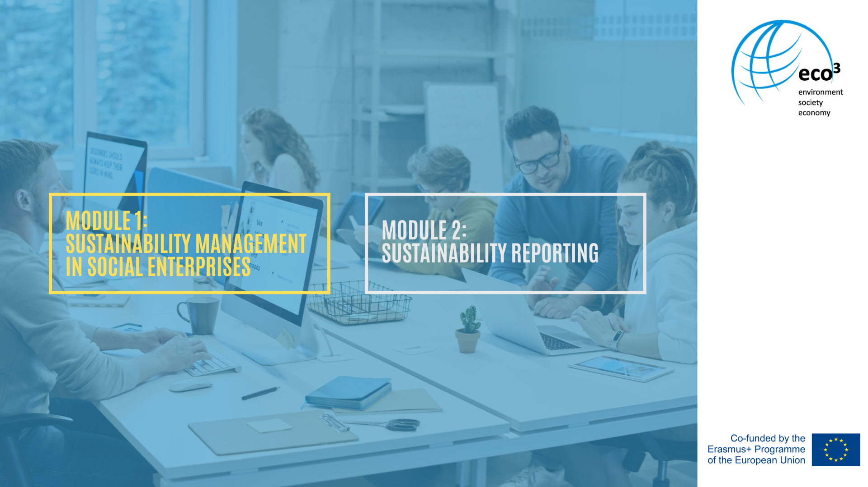

Slide 3
Overview of the module
Definition of sustainability management
Role of the sustainability manager
Sustainability management requirements and implementation

Slide 4
Definition of sustainability management
Extends the regular management systems by combining the three dimensions of sustainability: ecological, social and economic
Daub, Scherrer and Frecè (2013): "a form of corporate management that is guided by the idea of reconciling the economic goals of a company with ecological and social concerns"
All business decisions are reclected in terms of social and environmental impact
Less common in social economy but necessary
Notes:
There are different management models which are discussed in regard of the social economy or the nonprofit sector like the St. Galler Management Model or the Frei-burger Management Model for Nonprofit . So far, they are not adapted for sustainability topics.
According to Weber (2008, p. 43), sustainability management combines the three dimensions of sustainability, the ecological, the social and the economic perspective (more on this: script no. 2), to form a new management approach. It therefore represents an extension of the mostly purely economically oriented management. Companies that want to manage these three target dimensions in an integrated way are con-fronted with major challenges. On the one hand, the target system becomes (even) more complex and also more extensive; on the other hand, the different targets can also cause target conflicts. Daub, Scherrer and Frecè (2013) describe sustainable management as "a form of corporate management that is guided by the idea of reconciling the economic goals of a company with ecological and social concerns". To this end, all corporate structures and processes are systematically examined to determine "what impact they have on business success and, at the same time, on the organisation's ecological and social environment" (ibid.) to achieve the most positive effects possible in all three areas. While companies are now following a certain social pressure and are therefore concerned with sustainability and sustainability management, the pressure is not as great on nonprofit organisations. This is mainly because their fields of action and the social or the ecological goals are perceived far more positively than those for making profit.
Nevertheless, social economy organisations have a duty of care for sustainability. They can also have a negative impact on people, animals and the environment through its activities. Even if social services are mostly associated with a lower consumption of resources and there is no production process that releases toxic wastewater, harmful emissions or noise and causes a heavy burden on the environment. Following a social mission for clients or society does not mean that there is no need to systematically ad-dress the various aspects of sustainability in an organisation (Stepanek, 2022).

Slide 5
Definition of sustainability management
In order to implement sustainability management
Clear goals and measurable indicators needs to be defined
The regular „numbers-oriented“ management is replaced by the integration of plans and reviews
A sustainability strategy must be defined
Notes:
In order to be able to take greater account of ecologically and socially sustainable goals in management, integrated planning along the triple bottom line is therefore needed. It must also be verifiable and controllable with clearly measurable indicators and key per-formance indicators. This means saying goodbye to management that has so far been almost exclusively numbers-oriented and turning to a far-reaching management approach that naturally integrates, plans, reviews, coordinates and internally negotiates economic, social and ecological aspects. It is not a matter of "greenwashing " selected areas, but of reflecting ecological and social aspects in one's own core business. This is a major change for the management of a company or organisation, regardless of whether it is profit-oriented or not.
Companies often have a CSR (cooperate social responsibility) department, which focus on the social and environmental responsibility of the company and is seen as a reaction to social issues identified by the company. This should not be mistaken for a company's sustainability management, which focuses on the whole company and that the company itself is made more sustainable. A sustainable strategy is followed and goals are set for it. The CSR department does not have to do this, the implementation of social or ecological activities remains voluntary and can also only include social or ecological activities.

Slide 6
Sustainability management requirements and implementation

Slide 7
Requirements for NPOs
Three requirements for NPOs (Daub, Scherrer and Frecè, 2013)
The organisation must locate itself and its goals in the manifold, sustainable goal system and must argue this location or focus to its stakeholders
The organisation must accept that sustainability can never be achieved 100%
The organisation must live with transparency
Notes:
Daub, Scherrer and Frecè (2013) identify three requirements for a NPO that has opted for sustainable management:
The organisation must locate itself and its goals in the manifold, sustainable goal system and must argue this location or focus to its stakeholders. It is advantageous that many aspects of social sustainability are already in focus or can be easily aligned with the organisation's values. Nevertheless, this could mean that the organisation justifiably turns away from certain sub-areas in order to avoid conflicting goals.
The organisation must accept that sustainability can never be achieved 100%. It is always about operating as sustainably as possible. Sustainability cannot be treated as a singular project but becomes a strategic element of the organisation.
The organisation must live with transparency. Only this transparency allows stakeholders to monitor the fulfillment of sustainability goals which also increases credibility. Transparency also makes it easier to monitor target achievement and to adjust current or future sustainability targets. This needs management thinking on the one hand and a more open attitude on the part of management on the other.

Slide 8
The implementation as a systematic approach
A systemetic approach must be pursued
Materiality analysis: an analysis of the aspects of sustainability that are relevant to the organisation.
Stakeholder definition: Involvement of relevant stakeholders in the discussion of sustainability.
Organisational anchoring: Strategic anchoring of sustainability
Sustainability reporting (sustainable annual reports, sustainability reports)
Notes:
Eller (2019, p. 16) highlights the importance of a systematic approach to the topic of sustainability. She speaks of the necessity of developing a sustainability concept and defines at least four areas in this regard that must be anchored in it:
1. Materiality analysis: an analysis of the aspects of sustainability that are relevant to the organisation.
2. Stakeholder definition: Involvement of relevant stakeholders in the discussion of sustainability.
3. Organisational anchoring: Strategic anchoring of sustainability
4. Sustainability reporting (sustainable annual reports, sustainability reports)

Slide 9
The analysis of the current situation
Detailed analysis of the initial situation is essencial:
analysis of the initial situation includes external and internal aspects
design of sustainable management: look at culture, structure and processes is intended to gather the existing information
analysis of human and financial resources: based on a resource analysis, expanding on intangible resources (e.g. know-how, image, market position).
Notes:
According to Daub's (2012, p. 69) model, it involves an analysis of the organisation's initial situation, sustainable management design, and monitoring and reporting of the achievement of economic, environmental, and social goals (Stepanek, 2022):
The analysis of the initial situation includes both external and internal aspects: According to an environmental analysis, the focus is primarily on ecological and social environmental factors that are relevant to the organisation.
A look at culture, structure and processes is intended to gather the existing information that is relevant for the design of sustainable management. This can provide initial starting points for identifying impacts on the natural and social environment and referring to them in the formulation of the sustainable strategy.
The analysis of human and financial resources can be based on a resource analysis, expanding on intangible resources (e.g. know-how, image, market position).

Slide 10
The process of implementation
Sustainability management supplements central management areas by sustainability topics
Stakeholder management based on stakeholder analysis
Dialog with stakeholders and employees in order to formulate sustainability strategy
Implement a corporate culture
Structures and processes must be designed sustainable
Design sustainable services
Notes:
In sustainability management, central management areas are supplemented by sustainability topics (Stepanek, 2022):
Stakeholder integration requires a systematic stakeholder management based on a stakeholder analysis, as is already used in NPO marketing or in the context of impact orientation considerations, but supplemented by social and ecological expectations.
The formulation of the strategy first requires that a picture of the future in the sense of a sustainable vision be developed with the involvement of all stakeholders. The management of the organisation thus enters into a dialog with the representatives of the various stakeholder groups.
In the sense of sustainable leadership, employees are also involved in the process of formulating a vision and strategy and are motivated to support the results.
This involvement of stakeholders and employees can also provide a significant impetus for the development of a sustainable corporate culture. Leadership issues are also important aspects in this context. For example, managers in particular must act in accordance with sustainability goals and adapt their targets accordingly.
The formulation of a sustainable strategy must both supplement the target level with social and ecological goals and examine the extent to which the organisation's resources and competencies correspond to this expanded target system and enable a sustainable strategy.
In line with the sustainable organisational culture and the formulated sustainable strategy, the organisation's system must be further developed, appropriate structures must be established and processes must be designed sustainably.
Finally, the organisation can also design its own services in such a way that they meet the requirements of sustainability.

Slide 11
Monitoring and reporting
The following topics should be adressed
Eco-effectiveness and socio-effectiveness
long-term organisational goals
the reporting must also include the social and environmental impacts and the measures for greater sustainability
There are certain tools and standards which do support the process
Notes:
In monitoring and reporting, a green controlling concept is established that focuses on environmental and organisational results and strives for both efficiency and effectiveness (Stepanek, 2022):
Eco-effectiveness and socio-effectiveness are about achieving the goals in terms of stakeholder expectations and ensuring that there are as few negative impacts as possible and as many positive impacts as possible.
Within the organisation, a system must be established that enables the monitoring and control of long-term organisational goals on the basis of economic, ecological and social efficiency.
In addition to describing the organisation's performance and its impacts and finances, the reporting must also include the social and environmental impacts and the measures for greater sustainability. Various standards and reporting guidelines can be used for this purpose.
Some reporting standards, which can be part of an organisations’ green controlling, are described in more detail in the second chapter. In addition to the standards, other tools can also be used to address sustainability issues in an organisation. Some take a standard and work with it, others find it not comprehensive enough or suitable for their organisation, so other tools are used to define further indicators or goals. As already mentioned by Eller (2019) and Stepanek (2022), a materiality analysis or a stakeholder analysis can be used as a tool. But also a PESTEL analysis can be used to deal with the effects of external environmental factors on an organisation. During the next slides you will find an example for each analysis:

Slide 12
Notes:
In general, a sustainable organisational strategy is not worked on right from the start. In practice, organisations and enterprises usually work in three stages: first they formulate their own sustainability strategy and then, after some time, they add sustainability topics to the organisational strategy. Finally, they design a sustainable organisational strategy only. To change an organisational culture towards sustainability, organisational goals, employee satisfaction and customer orientation must be brought into balance. The following figure shows which measures can be taken to achieve this (Stepanek, 2022).

Slide 13
Materiality analysis
The materiality analysis can be used as a first step towards starting a sustainability process
The central topics for the core buisness are identified
What impact on sustainability do they have?
What relevance for the organisation do they have?
For each topic and area key figures and indicators are defined
Notes:
The materiality analysis can be used as a first step towards starting a sustainabil-ity process.
“An organisation is faced with a wide range of topics on which it can report. Rel-evant topics, which potentially merit inclusion in the report, are those that can reasonably be considered important for reflecting the organisation’s economic, environmental, and social impacts, or influencing the decisions of stakeholders. In this context, ‘impact’ refers to the effect an organisation has on the economy, the environment, and/or society (positive or negative). A topic can be relevant – and so potentially material – based on only one of these dimensions.” (GRI, 2016, 10)
This means taking a look at which topics are central to the core business, what impact do they have on the dimensions of sustainability and what relevance do they have for the organisation itself and for its stakeholders. In the following, 10 areas are presented in a matrix, which have been identified as essential topics for the organisation xy.

Slide 14
Stakeholder Analysis
Central Question:
Which stakeholders have an impact on the success of the organisation
Procedure:
List relevant stakeholder groups
Groups are numbered according to their influence
The attitudes and provided resources are listed
The expectations of the stakeholders about sustainability are listed
Notes:
To find out which stakeholders are relevant to the organisation and have an im-pact on the success of the organisation, a stakeholder analysis can be done.
Stepanek (2022) shows an example of a stakeholder analysis based on a facility for homeless people with an open lunch table. First, the relevant stakeholder groups were listed, then they were numbered according to their influence (1 very high, 2 medium, 3 low) and the attitudes and resources they provide were listed. With the help of the SDGs, the expectations of the stakeholders about sustainability were then listed.

Slide 15
Stakeholder | Influence | Attitudes/ values/ conflicts | Resources | Sustainability expectations
Funding body | 1 | Expects quality and cost-efficient implementation of the work of the state institution. | Funding for stationary services (service contract), Influence on political decision-makers | 1 No poverty 2 Zero hunger 3 Good health and well-being 10 Reduced inequalities 16 Peace, justice and strong institutions
Residents | 1 | Uses the service, but are rather critical | Access to other networks, trust, sometimes volunteer work | 1 No poverty 2 Zero hunger 3 Good health and well-being 7 Affordable and clean energy
Residents in the immediate sur-roundings | 2 | Want peace in the district, care about the image of the town, support through donations | Social acceptance, donation of time and money | 1 No poverty 2 Zero hunger 3 Good health and well-being
Notes:
If the organisation is not clear about the attitudes and expectations of the stakeholders concerning sustainability, interviews or questionnaires addressed to the stakeholder groups can also provide information.

Slide 16
PESTEL analysis
P olitical
E conomioc
S ocial
T echnological
E nvironmental
L egal
Identify relevant topics
Collect data in order to estimate impact
Classify the degree of influence
Notes:
These represent six different environments. In terms of sustainability, it is therefore important to look at the influence of the environments on sustainability. For an analysis, it is not necessary to look at all six in detail. Only the relevant ones are identified. This is followed by a specification of topics that relate to the selected environments.
Once the relevant issues have been identified, further data needs to be collected to estimate their impact on the organisation.
Then they are classified according to their degree of influence, e.g. 1-5. This should give the organisation an overview and support the implementation of the sustainability strategy (Stepanek, 2022).

Slide 17
PESTEL analysis
Political | Socio-Cultural | Environmental
Legislation Political stability Tax guidelines Subvention Foreign policy Social policy Founding | Language skills Demographic population development Religion Values, norms Education Income distribution Leisure, lifestyle | Environmental regulations Changes in purchasing behaviour Sources of raw materials Climate change Consumption Recycling, disposal Air pollution
Notes:
TOn this slide the students can see examples for topics of the PESTEL-Analysis.

Slide 18
Summary

Slide 19
Sustainability management
Describes a holistic, integrated management approach
Based on sustainability strategy
Analyses the enterprise/ organisation
Describes sustainability management goals
Uses green controlling instruments
Produces sustainability reports
Establishes measuses derived from the strategy
Notes:
Stepanek (2022) summarises that sustainable management
describes a holistic, integrated management approach that not only pays attention to key financial factors, but also takes environmental and social goals into account,
is based on a sustainability strategy that complements the strategy or, ideally, implements sustainability goals into the organisation's strategy,
analyses the enterprise or organisation, usually based on standards, guidelines or reporting templates, to identify the key areas of sustainability for that organisation (materiality analysis),
describes sustainable management goals for the material areas in order to develop concrete plans and measures from them,
uses green controlling instruments to monitor and control its plans and the degree of achievement of objectives, and
presents its efforts and achievements in a sustainability report.
The monitoring of the goals and achievements is especially important to see which measures have already been effective and which may not be, so that improvements must be made or factors that are limiting the achievement of goals must be identified. For this purpose, it is possible either to orientate oneself on the changes of the past years or to research comparative data.
The sustainability reports must also be carried out several times so that a development can be made visible (more about monitoring and controlling in script no. 4).
Sustainability measures can now be defined by dealing with the described analyses or during a reporting standard on the essential topics for the organisation.

Slide 20
Role of the Sustainability Manager
Main Activities
Integration and implementation of sustainability
Communication and networking
Cooperation with various departments to develop sustainable solutions
Cooperation with other stakeholders
Prepare financing and investment plans
Creation and evaluation of meaures
Monitoring and supporting the implementation process
Preparing sustainability reports
Notes:
The tasks of a sustainability manager are diverse and may be different in one organisation than in another. But in summary, a sustainability manager may be involved in the following activities:
Integration and implementation of social, ecological and economic sustainability in the organisation (through projects maybe but especially by integrating them into the organisation's strategies).
Communication, networking and spreading the idea of sustainability within and outside of the organisation (making it public, in a way).
Cooperation with various departments in an organisation (management, controlling, technical services, individual counselling centres, etc.) to develop sustainable solutions that fit properly.
Cooperation with other stakeholders to ensure the implementation of the sustainability strategy (e.g. public authorities, consulting offices, construction companies, other NGOs, etc.).
Monitoring and supporting the implementation of sustainability strategies and projects.
Analysis and documentation of operational processes and the preparation of sustainability reports.
Creation of measures for implementation and the regular evaluation of whether the measures need to be changed, whether they guarantee an improvement and possible adjustments to the measures and goals.
Prepare financing and investment plans for the implementation of the sustainability strategy.
Pass on and distribute tasks to the different employees.
Of course, it always depends on the size of the organisation, to what extent it has its own sustainability manager and with which departments this manager works. In very small organisations, this can also be done by the management, for example.

Slide 21
Practical Example: Café Nase (CZ)
Notes:
Some facts are presented on the slides, the whole practical example can be found in the script 3, chapter 1.4.

Slide 22
Café Nase I
Café Naše is a social enterprise that employs people to treat addictions and allows them a meaningful restart into life in a professional environment.
The key activities are:
Operation of the café – sale of coffee and cakes, production of cakes
Education and employment of workers (social rehabilitation)
Target group
At least 40 % of the employees belong to disadvantaged groups.
Jobs are reserved for people in addiction treatment.

Slide 23
Café Nase II – environmental sustainability
They reduce waste and offer coffee in returnable cups within the project “Turn the cup” and by recycling different materials. They buy large packages of anything and essentially in returnable glass bottles.
They save energy by the usage of energy-efficient appliances and LED lighting.
By use of environmentally friendly cleaning products they cut the amount of water pollution.
They have a strong local principle. The cafe uses products from local farmers. It involves local actors in cooperation (local authorities, labor offices, schools, social organisations, etc.).
Notes:
If an organisation starts for the very first time to think about a sustainability strategy or different measures to take to be more sustainable in the future, it is much easier to focus only on several aspects of the three dimension of sustainability or to choose only one of these three dimensions. Year by year, they can take more aspects into account. This should help managers to reduce the complexity and to make sure, not to lose the motivation to go on in the future. As soon as there is some experience how to define goals and measures for sustainability in several fields, one can start with a much more complex sustainability management system by using one of the different frameworks or standards.
Here are examples to start with, like Cafe Nase did.

Slide 24
Café Nase III – social sustainability
They adequately adapt working conditions and the environment to the needs and capabilities of employees.
P-center clients who go through the program (training on the job) will thus gain demonstrable experience (customer service, coffee preparation, food preparation) and a credit report.
They will gain work habits, learn to express their needs, communicate with colleagues and superiors and try to act as a contractor, everything in the protected environment of a social enterprise.
Notes:
Café Nase is a project with high demand for social sustainability by creating social impact and on working conditions for its employees.

Slide 25
Café Nase IV – social sustainability
As a result, they are equipped with such abilities, skills and demonstrable advantages for better employment. At least 40% of employees are disadvantaged in the labor market.
Ethical principles and principles of working with a target group of people with addiction are observed.
Employees participate in the management of the company at regular meetings. They strive for the professional development of employees, and they increase their skills and ability to compete in the open labor market.

Slide 26
Café Nase V
The social enterprise does not distribute the profit among the business owners. They invest it into different other activities or keep it as a financial resource for the future to finance investments. This is one important aspect of economic sustainability.
Examples of SDGs they address
Goal 1: People with addictions are employed and return to society is encouraged.
Goal 4: The social enterprise educates and retrains people from the target group.
Goal 12: The social enterprise uses an environmentally friendly method in the operation of the cafe.
Notes:
More SDGs:
SDG 3: The social enterprise supports people with addictions in a healthy lifestyle and working conditions are adapted to their abilities.
SDG 5: Equal opportunities for employees.
SDG 8: The social enterprise develops business potential.
SDG 10: The social enterprise focuses on the employment of people with addictions and their social resocialization.

Slide 27
Practical Example: R.U.S.Z. (AT)
Notes:
Some facts are presented on the slides, the whole practical example can be found in the script 3, chapter 1.4.

Slide 28
R.U.S.Z. I
Vision/targets | Repair and Service Center The vision is: Out of the hamster wheel of material satisfaction of needs - into a good life for all!
Key activities/ working fields | Repair services for electrical products, product service and sale of used products Operation of the repair café "Schraube 14" (Screw 14) Running a network of repair specialists Sale of second-life products Equipment rental for washing machines Vocational training of formerly long-term unemployed people, trainees and people with refugee background Lobbying at EU policy level
Target groups | Long-term unemployed people People with refugee background

Slide 29
R.U.S.Z. II Connex and Contribution to sustainability
Action principle: "Use longer instead of buying more often” → importance of resource conservation
Strategic goal: combine ecological necessities with labour market policy demands
Employment of people with refugee background and long-term unemployed people
Small salary range between employees and management/shareholders
Independent work, part-time work models & paternity leave possibilities
Notes:
There is a flat hierarchy in the company and much attention is paid to independent work. The wages and salaries paid are subject to the metal industry’s collective agreement and the wage and salary scheme is transparent for everyone. In cases where this is justified, there is also a bonus based on individual results. The salary range between employees and management/shareholders is very small and thus, high-performing productive workers earn more than shareholders.
Indicators
A CO₂ report was prepared based on the Greenhouse Gas Protocol Corporate Standard (GHG Protocol) and specific company operation data. According to the emissions report, the company emitted 45 tons of carbon equivalents. Thus, R.U.S.Z is in the lower range compared to other companies in its sector and size, compared to 59 tons saved through repair services and reuse.

Slide 30
R.U.S.Z. III - SDGs
The organisation contributes to a wide range of different SDGs.
The most important ones are:
Goal 4: In addition to unlimited employment, the employees have the opportunity to receive specialized training.
Goal 5: R.U.S.Z supports the educational training of women through specific programs and courses such as "Women in Technology".
Goal 8: The employees get fair working conditions and due to the flat hierarchy in the company, the employees' participation is given.
Goal 10: Small salary range → it is also possible for workers to earn more than shareholders due to individual performance and bonuses.
Goal 12: Repair services contribute to responsible consumption and reduce production’s toxic waste or pollutants.
Goal 13: As a result of the repair services carried out, more than 59 tons of carbon dioxide were saved, thereby generating a significant positive impact on the climate.
Notes:
Goal 4: A good and solid education and the learning of skills are important in order to obtain a sufficient income. The company's employees are mainly former long-term unemployed.

Slide 31
Practical Example:
Brüderhaus Diakonie (DE)
Notes:
Some facts are presented on the slides, the whole practical example can be found in the script 3, chapter 1.4.

Slide 32
Bruderhaus Diakonie I
Vision/ targets | The main target of the Bruderhaus Diakonie is to enable people to participate in modern society. To achieve this goal, the foundation offers several services in different working fields.
Key activities/target groups
Elderly Care | Youth welfare | Disability assistance | Social psychiatry | Education
outpatient services services for dementia short term care shared apartments for seniors inpatient care service living | consultation refugee services kindergarten social work at schools animal assisted therapy | inpatient care outpatient care consultation leisure offers workshops for disabled people integration into the labour market | consultation assisted living psychiatric treatment and rehabilitation personal budget | services for unemployed people and migrants professional advancement for young and disabled people workshops

Slide 33
Bruderhaus Diakonie II The integration of sustainability into management
Management areas | Implementation at „Bruderhaus Diakonie“
Stakeholder Integration | Integrating the EMAS-Certification System and providing transparency of sustainability topics.
Employee Integration | Founding a fund for sustainability. Ideas, projects and measures are realized by using the money from the funding pot. By directly addressing the employees the Bruderhaus Diakonie is also seen as a more lucrative employer.
Development of a sustainable corporate culture | Every year one SDG gets put into the focus of the organization.
Formulation of a sustainable strategy | The Strategy mainly involved the following aspects of economic sustainability Usage of Green Energy Expansion of E-Mobility The protection of species
Notes:
Stakeholder Integration
Execution of a Stakeholder analysis which is supplemented by social and ecological expectations
Formulating a strategy for the future by entering a dialog with the representatives of the various stakeholders
Employee Integration
Employees should also be integrated in the process of formulating a vision and strategy
Through this integration the employees are motivated for the change process
Development of a sustainable corporate culture
Every member of the organisation, but in particular the manager must act by following the sustainability goals and adapt their targets accordingly
Formulation of a sustainable strategy
Supplement the target level with social and ecological goals
Examine the extent to which the organisations resources and competencies correspond to this expanded target system

Slide 34
Bruderhaus Diakonie III The integration of sustainability into management
Management areas | Implementation at „Bruderhaus Diakonie“
Transforming the organisational structure | By now the main processes that have been realized are: Green Energy: the Bruderhaus Diakonie is only using energy from renewable sources and is producing energy themselves by using photovoltaic systems. Expansion of E-Mobility: the Bruderhaus Diakonie is changing its carpool and is relying more on E-Mobility, by providing E-Cars, E-Bikes and charging stations. The protection of species: inside Project BeeD the Bruderhaus Diakonie provides multiple Beehives that the clients operate.
The organisation is now able to design its own services in such a way that they meet the requirements of sustainability
Notes:
Transforming the organisational structure
By implementing the strategy the organisation's system must be further developed, appropriate structures must be established and processes must be designed sustainably

Slide 35
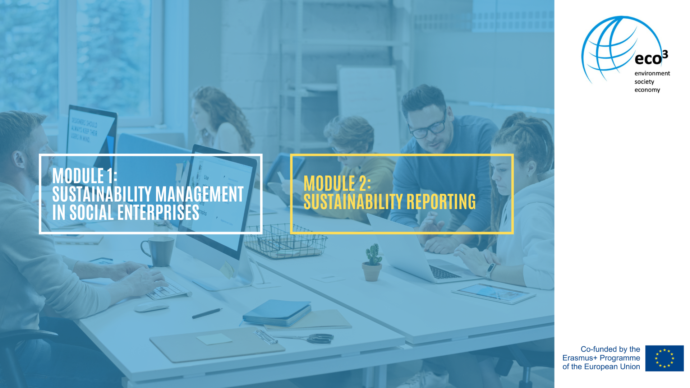

Slide 36
Overview of the module
General Information
Eco-Management and Audit Scheme (EMAS)
Global Reporting Initiative (GRI)
Reporting Schemes
ISO 14000:2015
United Nations Global Compact (UNGC)
Economy for the Common Good
Science Based Targets

Slide 37
General Information
Sustainability Reporting
Requires the gathering of information and data
Creates greater transparency
Helps to identify the key issues to focus on
Helps to find gaps and opportunities in sustainable performance
Encourages to set goals
Notes:
Sustainability reporting requires gathering information and data. Presentation of this information creates greater transparency for both internal and external stakeholders about the sustainability performance and can help to identify key issues to focus on and, accordingly, improve productivity and reduce costs.
Reporting annually is a valuable way to identify gaps and opportunities and to continuously improve sustainability performance. It can provide the organisation with a benchmark of current and past performance in various aspects of the social business and sustainability, and encourages them to set improvement targets.

Slide 38
General Information
Who needs to report?
By 01.01.2024 the following are forced to produce Sustainability Reporting
All companies listed on a regulated EU market (not including micro-entities)
Large companies that are not listed on a regulated EU market
Balance sheet total: 20 million €
Turnover net: 40 million €
250 employees
Notes:
Large companies that are not listed on a regulated EU market, however, exceed at least two of the following three criteria: Balance sheet total € 20 million / Turnover net € 40 million / 250 employees.

Slide 39
Reporting schemes
Presents a standardised way to report environmental and social performance
Demonstrates an organisations commitment to sustainability to internal and external stakeholders
There are several standards - the general approach is always the same:
collect data → analyse data → interpret the data
Notes:
A reporting system enables organisations to report on their environmental and social performance in a standardised way. This is not just about producing reports based on collected data, but also a method of demonstrating an organisation's commitment to sustainable development to internal and external stakeholders through the reporting system.
There are several sustainability reporting frameworks, and although some aspects overlap, they differ in others. Each standard has its rules of application as well as approaches to area and indicator identification. Mostly they are based on proven management practices such as those of the PDCA (Plan-Do-Check-Act) circle. But the general approach is always the same: collecting data, analysing and interpreting these data. The results are then usually summarised in a report.

Slide 40
Global Reporting Initiative
Modular structure
GRI 101: Basis | Principles of reporting Basic requirements Materiality analysis
GRI 102: General disclosures | General information
GRI 103: Management approach | Additional notes Recommendations
GRI 200 | Economy
GRI 300 | Environment
GRI 400 | Social issues
Notes:
The GRI Sustainability Reporting Guidelines provide reporting principles, standard disclosures, and implementation guidance for creating sustainability reports for all organisations, regardless of size, industry, or location.
An essential part are indicators (for example energy consumption, etc.), which are also mapped in the ESG-Tool and automatically calculated.
The guidelines also provide an international reference for corporate governance information as well as environmental, social and economic performance data and implications.
The so-called “GRI Standard” is the most up-to-date version of the Guidelines and aims to provide valuable information about the organisation’s key sustainability issues to stakeholders and to make the preparation of such sustainability reports a standard practice.
The GRI-standard has a modular structure:
In the basis (GRI 101), the principles of reporting, basic requirements and application notes are included and with the help of the "materiality analysis" the most important topics for the company are worked out. Here it can be identified which topics are relevant for the company and which should be reported on.
The section "General Disclosures" (GRI 102) provides general information and the section "Management Approach" (GRI 103) lists additional notes and recommendations.
The 33 thematic standards are divided into GRI 200 for the economy, GRI 300 for the environment and GRI 400 for social issues. By selecting certain indicators, a "GRI-related report" is produced, for example only for the environment. Which topics are covered depends entirely on the company's area of interest (GRI, 2021).

Slide 41
Practical Example:
“Wien Work“
Notes:
Practical Example

Slide 42
Overall Standards | Examples of indicators
GRI 200 – 207: Economy | Overview of the most important locations Ownership structure and legal form Profile of the organisation: size of the organisation Profile of employment Description of the supply chain
GRI 300 – 308: Environment | Energy consumption of the organisation Reducement of the energy consumption Quantity of waste Quantity of pollutions Ecological effects of transport
GRI 400 – 408: social issues | Consultation or monitor programs for safety and health Programs for competence management and life-long-learning Amount of discrimination incidents and solvings
Notes:
The organisation Wien work published a GRI Report in 2014. This slide shows some Examples for indicators which the organisation defined for the GRI.

Slide 43
Eco-Management and Audit Scheme
EMAS measures the performance of the organisation in the following key areas
Energy
Materials
Water
Waste
Biodiversity
Emissions
Notes:
EMAS is a voluntary European Union instrument that helps businesses and organisations of all sizes and industries to continuously improve their environmental performance.
EMAS encourages companies and organisations to take responsibility for their own actions, and promotes cooperation between the economy and ecology.
The increase in environmental performance usually also leads to improved competitiveness.
Sustainable corporate development must take into account ecological as well as social and economic aspects. In this regard, EMAS environmental management provides a good basis for sustainable management.
The following core indicators need to be considered and they apply to all types of organisations.
They concern environmental performance in the following key areas:
Energy
materials
Water
Waste
Biodiversity
Emissions
In addition, EMAS environmental management takes into account the criteria of transparency (environmental statement) and increased legal security (EMAS, 2021).

Slide 44
Practical Example:
“Bruderhaus Diakonie“
Notes:
Practical Example

Slide 45
Practical Example – Bruderhaus Diakonie I
Location: Germany
Organisation: non-profit foundation
Vision/ targets: enable people to participate in modern society by offering several services in different working fields.
Services:
Elderly care: outpatient services, short term care, service living etc.
Youth welfare: consultation, kindergarten, social work at schools etc.
Disability assistance: inpatient care, outpatient care, leisure offers etc.
Social psychiatry: consultation, assisted living etc.
Education: workshops, services for unemployed etc.
Notes:
Location: Germany
Organisation: non-profit foundation
Vision/ targets: enable people to participate in modern society by offering several services in different working fields.
Services:
Elderly Care: outpatient services, short term care, service living etc.
Youth Welfare: consultation, kindergarten, social work at schools etc.
Disability Assistance: inpatient care, outpatient care, leisure offers etc.
Social psychiatry: consultation, assisted living etc.
Education: workshops, services for unemployed etc.

Slide 46
Practical Example – Bruderhaus Diakonie II
Key Areas | Input or Impacts
Energy efficiency | Total direct energy use Total renewable energy use
Material efficiency | Annual mass-flow of different material used
Water | Total annual water consumption
Waste | Total annual generation of waste Total annual generation of hazardous waste
Biodiversity | Land use
Emissions | Total annual emissions of greenhouse gases Total annual air emissions
Notes:
The implementation of a sustainability management system into the foundation began in 2010 by implementing the EMAS certification system. By now all business areas, the administration and the internal cooking services are certificated by the EMAS system.
The implementation of the EMAS-Certification was achieved through a clustering of the different working areas of the organisation. Those clusters were submitted to the external certificatory which chooses spot checks on a regular basis.

Slide 47
ISO 14000:2015
International standard to provide structure and framework
Based on a Plan-Do-Check-Act (PDCA) method
Identifiys and develop KPIs for resource-intensive areas
Should help the organisation to improve their environmental performance
Notes:
The aim of an environmental management system is to record, evaluate and make continuous improvements to the specific environmental impacts and the environmental regulations relevant to the company. The international standard ISO 14001:2015 provides the structure and framework for this and the continuous improvement process is based on the Plan-Do-Check-Act (PDCA) method.
Many companies and organisations are familiar with key performance indicators (KPIs) and these figures are often used for cost-profit analysis and other business management aspects. ISO 14001:2015 also requires companies to identify and develop KPIs for resource-intensive areas such as production and logistics. Based on these indicators and assessments, companies should systematically improve their environmental performance. Key figures should also be developed for the products that a company manufactures, where this makes sense (ISO, 2021).

Slide 48
Practical Example:
“Behindertenhilfe Norden GmbH“
Notes:
Practical Example

Slide 49
Practical Example Behindertenhilfe Norden GmbH I
Location: Germany
Organisation: limited liability company
Vision/ targets: to achieve the integration of disabled people into all areas of society
Key activities:
Disabled children
Assisted living
Outpatient living
24-7-care
Education for the labour market
Leisure options

Slide 50
Practical Example Behindertenhilfe Norden GmbH II
The certification is relating to the following aspects of the organisation
Planning: definition of environmental goals, measures, responsibilities, and processes.
Execution: implementation of the set measures and processes.
Control: control of the responsibilities and measures in context of the environmental goals of the organisation
Improvement: adjustment of the responsibilities, processes, and measures plus the environmental goals
Notes:
The overall goal of the ISO 14001: 2015 standard is: Companies should systematically improve their environmental performance based on these key figures and evaluations. This should also be implemented for the products that a company creates. On top of that new key figures should be developed where this makes sense.
In the case of “Behindertenhilfe Norden GmbH” the certification is relating to the follow-ing aspects of the organisation:
- Planning: definition of environmental goals, measures, responsibilities, and pro-cesses.
- Execution: implementation of the set measures and processes.
- Control: Control of the responsibilities and measures in context of the environ-mental goals of the organisation
- Improvement: adjustment of the responsibilities, processes, and measures plus the environmental goals

Slide 51
United Nations Global Compact (UNGC)
Largest network and stakeholder platform for corporate responsibility and sustainability
Goal: to make progressive globalisation more socially and ecologically sustainable
Central elements: 10 universal principles with connection to the SDGs
Notes:
Central Elements: see next slide

Slide 52
10 universal principles
Human Right | Businesses should support and respect the protection of internationally proclaimed human rights Businesses should ensure that they are not complicit in human rights abuses
Work | Businesses should uphold the freedom of association and the effective recognition of the right to collective bargaining. the elimination of all forms of forced and compulsory labour the elimination of child labour the elimination of discrimination in employment and occupation
Environment | Businesses should manage environmental challenges prudently Businesses should take initiatives to promote greater environmental responsibility environmentally friendly technologies should be encouraged in their development and diffusion
Anti-Corruption | Businesses should work against corruption in all its forms, including extortion and bribery.
Notes:
The UNGC is the largest network and stakeholder platform for corporate responsibility and sustainability and was launched by Kofi Annan (Secretary-General on the United Nations) in 2000.
Its aim is to make progressive globalisation more socially and ecologically sustainable. Central elements are the commitment to 10 universal principles as well as the binding support of the SDGs (Sustainable Development Goals). In addition, the network offers information and tools for the implementation of measures in practice.
The 10 principles are divided into 4 different thematic areas.
Human Right
Principle 1: Businesses should support and respect the protection of internationally proclaimed human rights
Principle 2: Businesses should ensure that they are not complicit in human rights abuses
Work
Principle 3: Businesses should uphold the freedom of association and the effective recognition of the right to collective bargaining.
Principle 4: the elimination of all forms of forced and compulsory labour
Principle 5: the elimination of child labour
Principle 6: the elimination of discrimination in employment and occupation
Environment
Principle 7: Businesses should manage environmental challenges prudently
Principle 8: Businesses should take initiatives to promote greater environmental responsibility
Principle 9: environmentally friendly technologies should be encouraged in their development and diffusion
Anti-Corruption
Principle 10: Businesses should work against corruption in all its forms, including extortion and bribery.
UNGC forms a management model that includes the following areas of activities.
Commitment from the leadership
Assess risks, opportunities and impacts across the 4 issue areas
Define goals, strategies and policies
Implement these policies through the company and the value chain
Measure and monitor impacts and the goal progress
Communicate the progress with stakeholders for continuous improvement
For communication issues the businesses must deliver a progress report called COP – Communication on Progress - once a year, which includes the UNGC statement of support, the description of concrete measures, the implementation of these as well as the quantitative/qualitative measurement of the results. Different levels are available for each type of organisation. Non-private organisations, on the other hand, only have to publish the COE - Communication on Engagement report every two years (

Slide 53
Seeks to establish an ethical economic model based on values that promote the common good
Common good balance sheet
Provides all stakeholders a comprehensive systematic view of the company's activities
Divided into 20 topics, which are checked for their social and ecological impacts
Individual contribution of the company: based on the common good matrix
Notes:
The common good economy seeks to establish an ethical economic model based on values that promote the common good (human dignity, solidarity and justice, environmental sustainability, transparency and co-decision). It is therefore also a driver for change at the economic, political and social levels and the goal of economic activity, is the well-being of people and the environment.
The common good balance sheet as a reporting tool is one of the most comprehensive reporting models, as it provides all stakeholders with a comprehensive systematic view of the company's activities.
The possibility of a common good balance sheet is not only available to companies / organisations, but also communities or educational institutions can make a balance sheet.
There is a division into 20 topics (business areas), which are checked for their social and ecological impacts and developed further with regard to values that promote the common good. The individual contribution of the company is presented based on the common good matrix.

Slide 54
Common Good Economy
Steps of preparation
Preparation | Usually every two years Data Collection → self-assessment → Evaluation
Audit | Audit the internal balance sheet from an external point of view Get a certificate Common good report and certificate → common good balance sheet
Publish | Publish the common good balance sheet
Notes:
The preparation of the common good balance sheet takes place in three steps:
Step 1 - Prepare a common good report: A common good report is usually prepared every two years. The qualitative reporting questions and quantitative indicators are presented using the common good matrix. After data collection, an assessment is carried out in form of a self-assessment, which shows how the specific value is realised in the company, which potentials are hidden behind it and which goals are being aimed at.
The self-assessment is supposed to evaluate the impact of the company's activities quantitatively and qualitatively in relation to the common good, in that the company / organisation classifies itself according to the scale. This promotes a value-oriented further development. The assessment levels describe activities and their potential impacts. Each assessment level is related to a scale range that indicates how far the company has already developed in this topic or to which point the different criteria have been fulfilled.
Step 2 – Audit: The next step is to audit the internally prepared public good balance sheet from an external point of view. This can be done as part of a peer group evaluation and is the preliminary stage to an audit certificate. If the audit is carried out by an auditor, the companies/organisations receive a final audit certificate and are certified as a "Balancing Company". The common good report and the certificate together represent the common good balance sheet.
Step 3 – Publishing: Finally, the common good balance sheet is published. This should give all interested people the opportunity to have a look at the common good balance sheets (Ecogood, 2021).

Slide 55
Practical Example:
ALLMENDA Social Business eG
Notes:
Practical Example

Slide 56
Practical Example – ALLMENDA Social Business eG
Location: Austria
Organisation: registered cooperative
Vision/ targets: Creating meaningful cooperations for a liveable future in the region
Key activities:
Development and promotion of regional projects to promote the region and its people
Regional currencies / service for complementary currencies: Development of voucher systems to keep purchasing power in the region, to maintain jobs and to contribute to the creation of regional goods cycles.
Regional renewable energy: realisation of photovoltaic power systems

Slide 57
Practical Example – ALLMENDA Social Business eG
Notes:
In general, the common good economy establishes an ethical economic model based on values that promote the common good (human dignity, solidarity and justice, ecological sustainability, transparency and co-decision).
The common good balance sheet as a reporting tool represents one of the most comprehensive reporting models of the EU reporting directive on non-financial reporting (NFI), as it enables a comprehensive systematic view of the company's activities to all stakeholders. Business areas (20 topics) are reviewed for their social, ecological impact and further developed on values that promote the common good. The individual contribution of the company is presented based on the common good matrix.
The following table gives an overview of the 20 business areas and shows the level of implementation by the organisation (in percent)
Allmenda Social Business eG (2019) takes the (re)balancing according to the criteria of the common good economy as an opportunity to further improve its own work and to create transparency regarding its own activities internally and externally. The report was prepared in the year 2019 and the process of balancing was accompanied by 3 employees (e.g. data collection, writing the report, participation in workshops and in the audit). In total, 100 working hours were spent on the preparation of the common good balance sheet.

Slide 58
Science based Targets - Foundation
initiative founded in 2015 by CDP (not-for-profit charity), UN Global Compact, World Resources Institute and WWF
provides a science-based methodology to set long-term greenhouse gas reduction targets.
Goal: develop a sustainability strategy and ensure a profitable corporate future
Notes:
Science Based Targets is an initiative founded in 2015 by CDP (not-for-profit charity), UN Global Compact, World Resources Institute and WWF. It provides a science-based methodology that enables organisations to set long-term greenhouse gas reduction targets. It calculates climate targets for the organisation that are in line with the Paris Climate Agreement.
The goal is to develop a sustainability strategy and ensure a profitable corporate future, e.g., climate neutrality, phasing out fossil fuels, halving energy consumption by 2050.
Participants in the Call to Action commit to achieving a science-based target within two years, which will be reviewed through the Science Based Targets initiative.

Slide 59
Science based Targets - Participation
The five steps of participation are:
1. commit to participate
2. development of the targets
3. submitting to SBT
4. communication
5. publication (Science based targets, 2021).

Slide 60
All sources of these Power Point slides can be found in the corresponding script.
The European Commission's support for the production of this publication does not constitute an endorsement of the contents, which reflect the views only of the authors, and the Commission cannot be held responsible for any use which may be made of the information contained therein.

Slide 61
You can use the next slides
for different activities.

Slide 62
e.g. for giving a time frame
Notes:
e.g. Time frame

Slide 63
e.g. to use it for group work
Notes:
e.g. group work

Slide 64
e.g. for content, use of script, homework
Notes:
e.g. content, use of script, homework

Slide 65
e.g. use ist for questions, discussiones, feedback
Notes:
Questions, discussions, feedback

Slide 66
e.g. for the using of materials (which materials their need)
Notes:
e.g. use of materials

Slide 67
e.g. conclusio, to dos
Notes:
e.g. conclusio, to dos

